Slide 1

Rockbuster Stealth
Data Dictionary
Allie Qualman

Slide 2
Table of Contents
Rockbuster Database Diagram…………………….…………………….……………….…………………….…………………….…………………………3
Payment….………….…………………….……………….…………………….………….………….…………………….……………….…………………….………………4
Rental…….………….…………………….……………….…………………….………….………….…………………….……………….…………………….………………..4
Store…….………….…………………….……………….…………………….………….………….…………………….……………….…………………….………………….4
Film Actor….………….…………………….……………….…………………….………….………….…………………….……………….…………………….…………..5
Inventory…….………….…………………….……………….…………………….………….………….…………………….……………….…………………….………….5
Film Category…….………….…………………….……………….…………………….………….………….…………………….……………….……………………….5
Customer…….………….…………………….……………….…………………….………….………….…………………….……………….………………………………..5
Staff…….………….…………………….……………….…………………….………….………….…………………….……………….…………………….……………………6
Actor…….………….…………………….……………….…………………….………….………….…………………….……………….…………………….…………………..6
Category…….………….…………………….……………….…………………….………….………….…………………….……………….………………………………….6
Language…….………….…………………….……………….…………………….………….………….…………………….……………….………………………………..6
Film…….………….…………………….……………….…………………….………….………….…………………….……………….…………………….…………………….7
City…….………….…………………….……………….…………………….………….………….…………………….……………….…………………….………………………7
Country…….………….…………………….……………….…………………….………….………….…………………….……………….…………………….……………..7

Slide 3
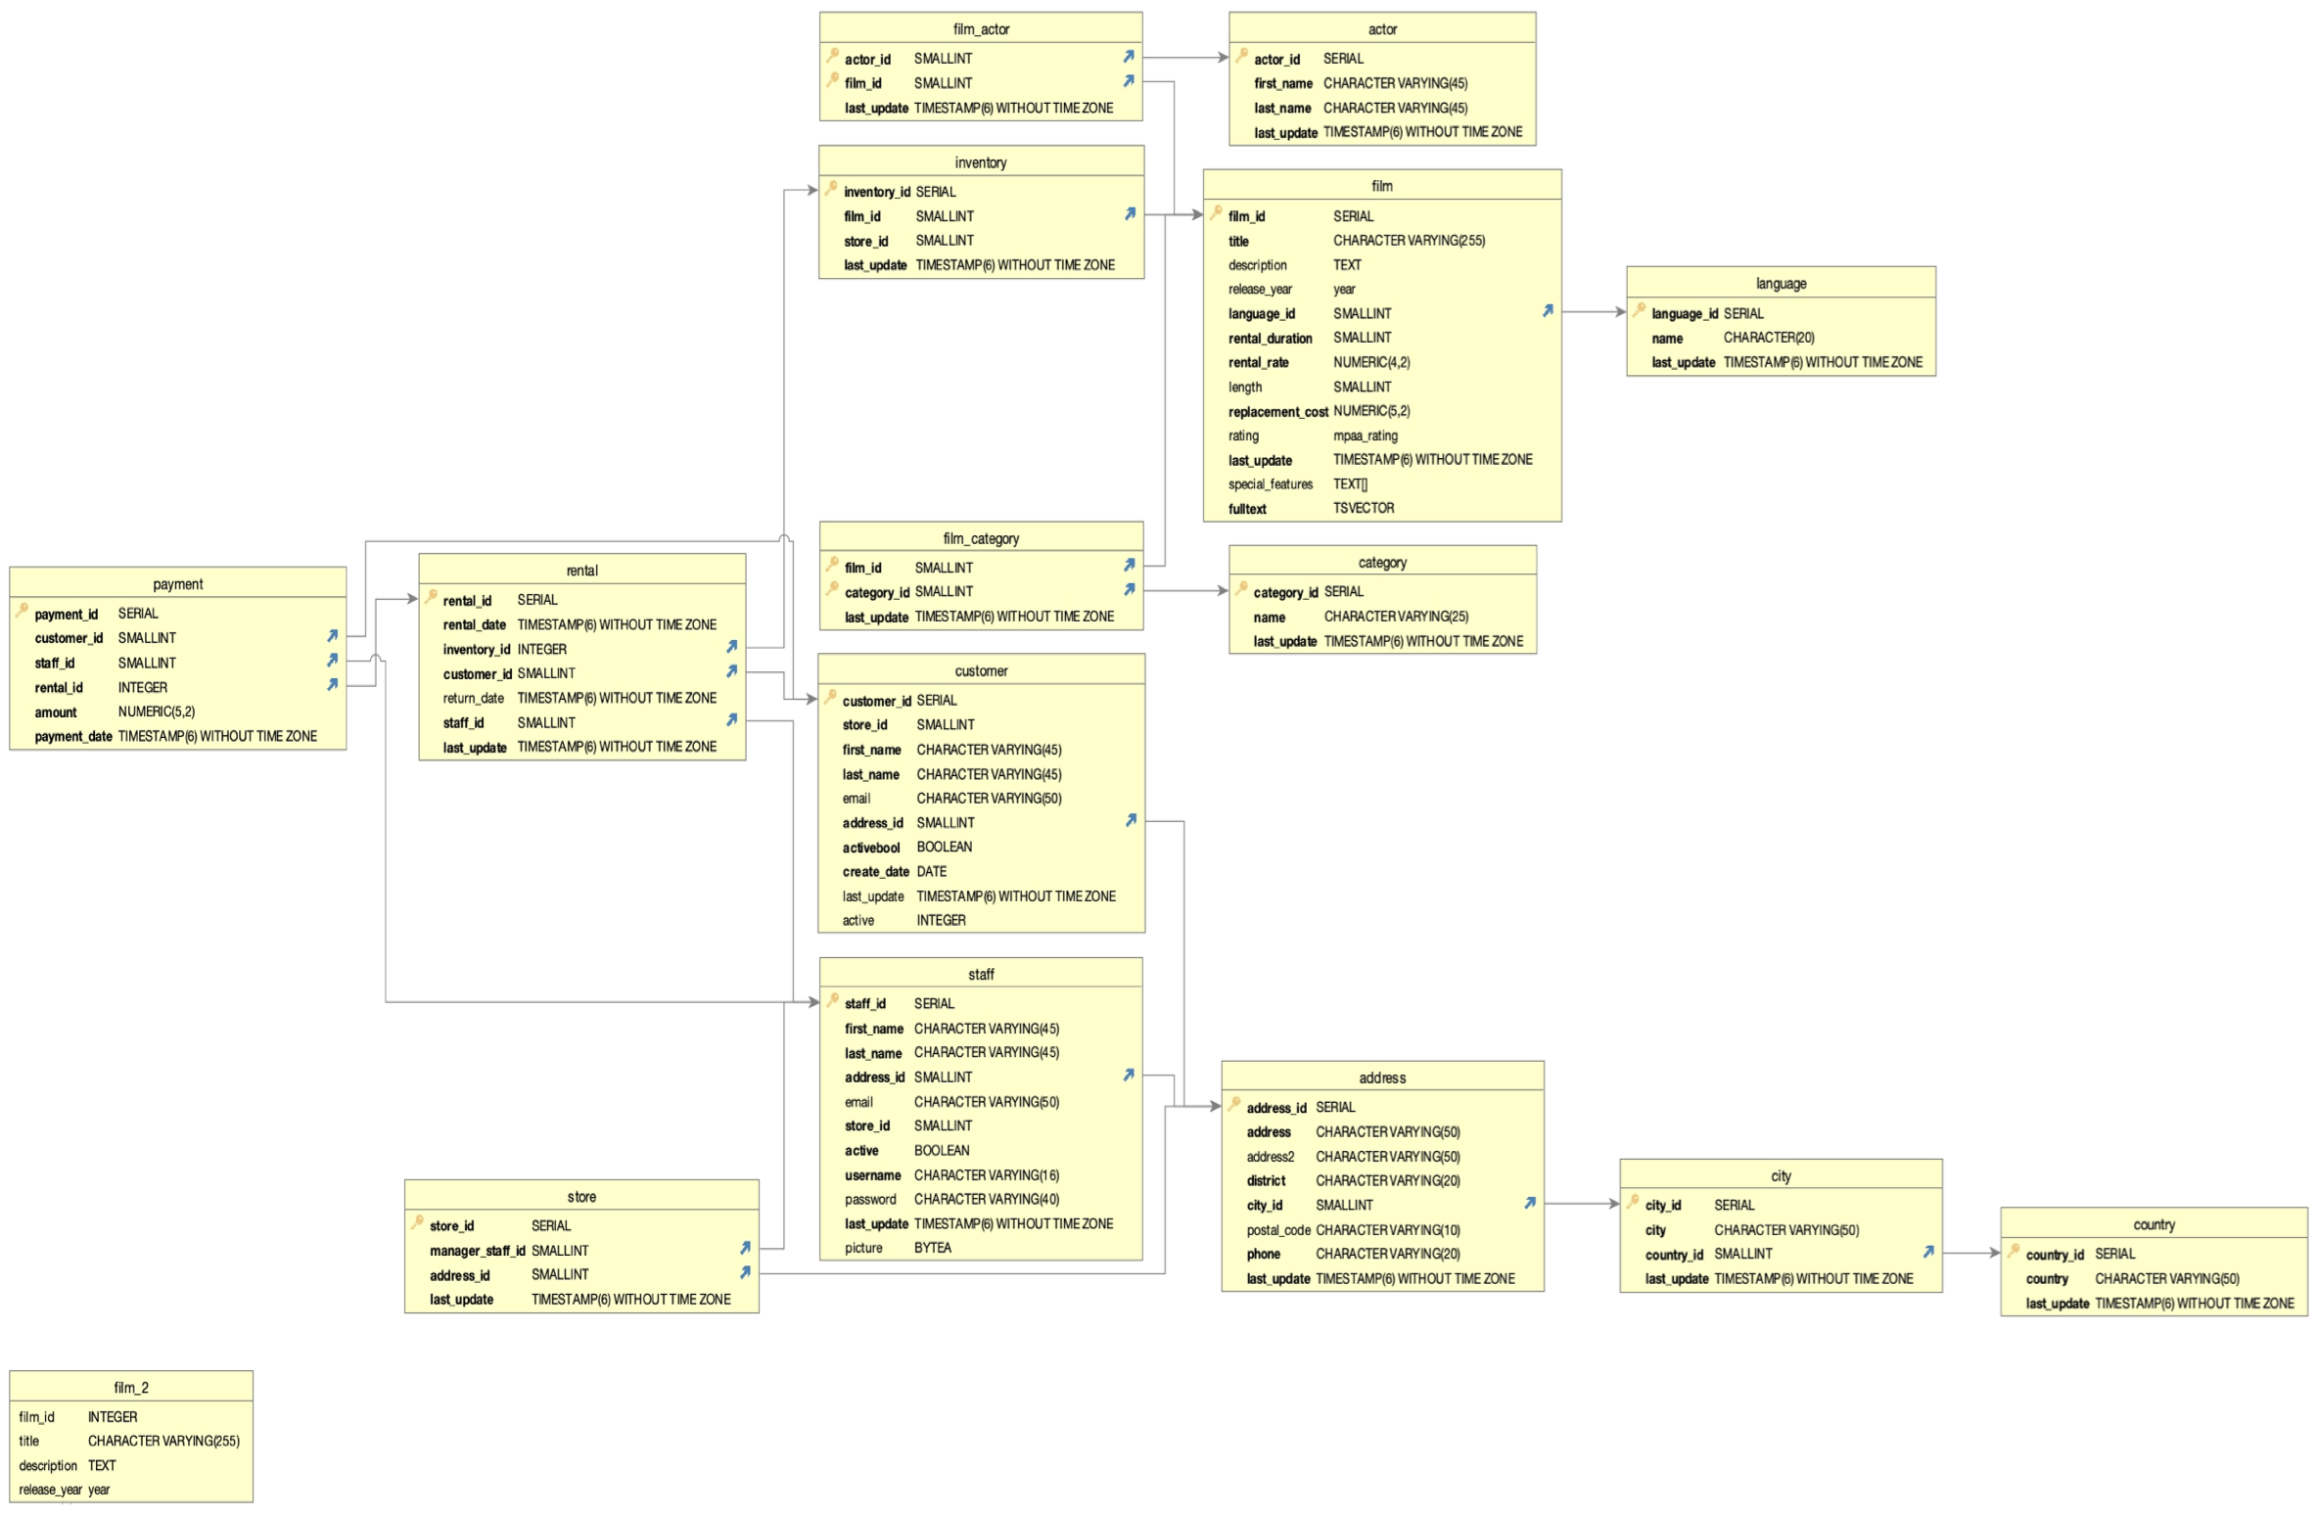

Slide 4
PAYMENT
Name | Data Type | Description/Attribute | Key | Links to | Links From
payment_id | SERIAL | Number assigned to payment | Primary Key
customer_id | SMALLINT | Number assigned to customer | Foreign | Customer
staff_id | SMALLINT | Number assigned to employee checking out customer | Foreign | Staff
rental_id | INTEGER | Number assigned to rental | Foreign | Rental
amount | NUMERIC(5,2) | Amount paid
payment_date | TIMESTAMP(6) WITHOUT TIME ZONE | Date of payment
RENTAL
Name | Data Type | Description/Attribute | Key | Links to | Links From
rental_id | SERIAL | Number assigned to rental | Primary Key |  | Primary
rental_date | TIMESTAMP(6) WITHOUT TIME ZONE | Date of rental
inventory_id | INTEGER | Number assigned to item | Foreign | Inventory
customer_id | SMALLINT | Number assigned to customer | Foreign | Customer
return_date | TIMESTAMP(6) WITHOUT TIME ZONE | Date rental returned
Staff_id | SMALLINT | Number assigned to employee checking out customer | Foreign | Staff
Last_update | TIMESTAMP(6) WITHOUT TIME ZONE | Date entry was last updated
STORE
Name | Data Type | Description/Attribute | Key | Links to | Links From
store_id | SERIAL | Number assigned to store | Primary Key |  | Customer
manager_staff_id | SMALLINT | Number assigned to manager | Foreign | Staff
address_id | SMALLINT | Number assigned to store address | Foreign | Address
last_update | TIMESTAMP(6) WITHOUT TIME ZONE | Date entry was last updated

Slide 5
FILM ACTOR
Name | Data Type | Description/Attribute | Key | Links to | Links From
actor_id | SMALLINT | Number assigned to actor | Primary Key | Actor
film_id | SMALLINT | Number assigned to film | Composite | Film
last_update | TIMESTAMP(6) WITHOUT TIME ZONE | Date entry was last updated
INVENTORY
Name | Data Type | Description/Attribute | Key | Links to | Links From
inventory_id | SERIAL | Number assigned to item | Primary Key |  | Rental
film_id | SMALLINT | Number assigned to film | Foreign | Film
store_id | SMALLINT | Number assigned to store |  | Store
last_update | TIMESTAMP(6) WITHOUT TIME ZONE | Date entry was last updated
FILM CATEGORY
Name | Data Type | Description/Attribute | Key | Links to | Links From
film_id | SMALLINT | Number assigned to film | Primary Key | Film
category_id | SMALLINT | Number assigned to genre | Composite | Category
last_update | TIMESTAMP(6) WITHOUT TIME ZONE | Date entry was last updated
CUSTOMER
Name | Data Type | Description/Attribute | Key | Links to | Links From
customer_id | SERIAL | Number assigned to customer | Primary Key |  | Rental, Payment
store_id | SMALLINT | Number assigned to store | Foreign | Store
first_name | CHARACTER VARYING(4 5) | First name of customer
last_name | CHARACTER VARYING(4 5) | Last name of customer
email | CHARACTER VARYING(5 0) | Email of customer
address_id | SMALLINT | Number assigned to customers address | Foreign | Address
activebool | BOOLEAN | Yes or no Active
create_data | DATE | Date entry was created
last_update | TIMESTAMP(6) WITHOUT TIME ZONE | Date entry last updated
active | INTEGER | Number assigned to active status

Slide 6
STAFF
Name | Data Type | Description/Attribute | Key | Links to | Links From
staff_id | SERIAL | Number assigned to employee | Primary Key |  | Payment, Rental, Store
First_name | CHARACTER VARYING(45) | First name of employee
Last_name | CHARACTER VARYING(45) | Last name of employee
address_id | SMALLINT | Number assigned to employees address | Foreign | Address
email | CHARACTER VARYING(50) | Email address of employee
store_id | SMALLINT | Number assigned to store | Foreign | Store
active | CHARACTER VARYING(16) | Active status
username | CHARACTER VARYING(40) | Username of employee
password | TIMESTAMP(6) WITHOUT TIME ZONE | Password of employee
picture | BYTEA | Picture of employee
ACTOR
Name | Data Type | Description/Attribute | Key | Links to | Links From
actor_id | SERIAL | Number assigned to actor | Primary Key |  | Film Actor
first_name | CHARACTER VARYING(45) | First name
Last_name | CHARACTER VARYING(45) | Last name
last_update | TIMESTAMP(6) WITHOUT TIME ZONE | Date entry updated last
CATEGORY
Name | Data Type | Description/Attribute | Key | Links to | Links From
category_id | SERIAL | Number assigned to genre catefory | Primary Key |  | Film Category
name | CHARACTER VARYING(25) | Name of category
last_update | TIMESTAMP(6) WITHOUT TIME ZONE | Date entry was last updated
LANGUAGE
Name | Data Type | Description/Attribute | Key | Links to | Links From
language_id | SERIAL | Number assigned to language | Primary Key |  | Film
name | CHARACTER(20) | Name of language
last_update | TIMESTAMP(6) WITHOUT TIME ZONE | Date entry was last updated

Slide 7
FILM
Name | Data Type | Description/Attribute | Key | Links to | Links From
film_id | SERIAL | Number assigned to film | Primary Key |  | Inventory
title | CHARACTER VARYING (225) | Title of film
description | TEXT | Description of film
release_year | year | Year film was released
language_id | SMALLINT | Number assigned to language film | Foreign | Language
rental_duration | SMALLINT | Length of rental of film
rental_rate | NUMERIC(4,2) | Price of rental
length | SMALLINT | Length of film
replacement_cost | NUMERIC(5,2) | Cost to replace film
rating | mpaa_rating | Film rating
last_update | TIMESTAMP(6) WITHOUT TIME ZONE | Date entry was updated last
special_features | TEXT[] | Description of special features in film
fulltext | TSVECTOR | Keywords of film
CITY
Name | Data Type | Description/Attribute | Key | Links to | Links From
city_id | SERIAL | Number assigned to city | Primary Key |  | Address
city | CHARACTER VARYING(50) | Name of city |  | Country
country_id | SMALLINT | Number assigned to country | Foreign |  | Country
last_update | TIMESTAMP(6) WITHOUT TIME ZONE | Date entry updated last
COUNTRY
Name | Data Type | Description/Attribute | Key | Links to | Links From
country_id | SERIAL | Number assigned to country | Primary Key |  | City
country | CHARACTER VARYING(50) | Name of country
last_updated | TIMESTAMP(6) WITHOUT TIME ZONE | Date entry last updated

